Slide 1
Beyond Free: Open Learning in a Networked World
for APT 2014 (8th July, Greenwich)
Stephen Downes
Notes:
https://showtime.gre.ac.uk/index.php/ecentre/apt2014/schedConf/index
As the concept of ‘open learning’ has grown it has posed an increasing challenge to educational institutions. First admissions were open, then educational resources were open and now whole courses are open. Proponents moreover are demanding not only that open learning be free of charge, but also that the resources and materials be open source – free for reuse by students and educators for their own purposes. This formed the basis for the original design of the Massive Open Online Course as a connected environment in which participants created and reused resources. In such a learning environment, the provision of education moves beyond the programmed delivery of instructional resources and tasks. Education is no longer ‘delivered’ (for free or otherwise) and instruction is no longer ‘designed’ in the traditional sense. Institutions are no longer at the centre of the ecosystem; their value propositions are challenged and new roles for professors and researchers must be found if they are to survive. In this talk Stephen Downes outlines the steps educational institutions must take to remain relevant: embracing the free and open sharing of knowledge and learning, underlining their key role as public institutions, and engagement in the lives and workplaces of people in the community.

Slide 2
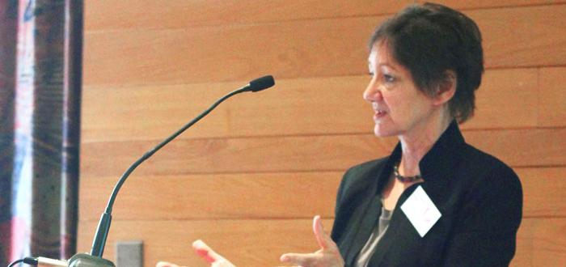
What is the problem for which MOOCs are the solution?
Diana Laurillard:
the answer to the question in terms of what problems MOOCs have solved…
"The problem MOOCs succeed in solving is: to provide free university teaching for highly qualified professionals."
https://newsletter.alt.ac.uk/2014/06/what-is-the-problem-for-which-moocs-are-the-solution/
Image: http://www.londoninternational.ac.uk/community/londonconnection/articles/qa/london-connection-qa-professor-diana-laurillard
Notes:
What is the problem for which MOOCs are the solution? Diana Laurillard, ALT Online Newsletter, Jun 26, 2014 Commentary by Stephen Downes
Diana Laurillard offers the answer to the question in terms of what problems MOOCs have solved, which seems to be a bit of an odd way to address a nascent technology. "The problem MOOCs succeed in solving is: to provide free university teaching for highly qualified professionals." Well, yes. And that's the problem the internet had solved by 1990, and the web by 1999. But surely that's not the extent of the problem-solving being does by open online content and services. I have always intended open online learning so address issues of access. Laurillard writes, "by 2015 there will still be 53m children out of school... UNESCO estimates that we need 1,600,000 teachers to achieve universal primary education." At $10K per teacher, that's an additional $16 billion in salaries; at $100K that's $160 billion. I see no sign anyone is prepared to pay this kind of money. So we need to address access in some other way than simply hiring teachers. Can MOOCs help here? Maybe. As Laurillard says, "If we are to have any hope of reaching our most ambitious educational goal of universal primary education, we have to find innovative ways of teaching." (p.s. - if you charge "even the modest cost of $49" it's not a MOOC). (p.p.s. this was posted on the ALT newsletter today; previously posted at IOE London blog May 14).

Slide 3
What is the problem MOOCs were designed to solve?
Laurillard writes, "by 2015 there will still be 53m children out of school... UNESCO estimates that we need 1,600,000 teachers to achieve universal primary education."
At $50K per teacher, that's an additional $80 billion in salaries
http://unesdoc.unesco.org/images/0022/002256/225660e.pdf
Image: http://www.thetimes.co.uk/tto/business/industries/publicsector/article3410805.ece

Slide 4
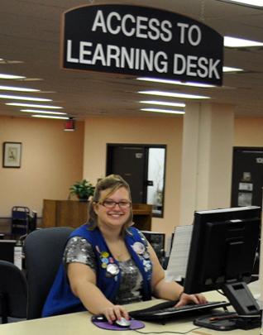
We have to find innovative ways of teaching…
… says Laurillard. But more importantly, I say, we have to find more innovative ways of learning
Because the problem isn’t design; the problem is cost and access. Design is only one way of looking at the problem.
Image: https://www.uwstout.edu/lib/services/access.cfm

Slide 5
Who gets to graduate?
"whether a student graduates or not seems to depend today almost entirely on just one factor — how much money his or her parents make....
“it will always be the case that the kids who have need are going to have been denied a lot of the academic preparation and opportunities for identity formation that the affluent kids have been given.”
http://www.nytimes.com/2014/05/18/magazine/who-gets-to-graduate.html?_r=0
Paul Tough, New York Times, May 27, 2014
Notes:
Who Gets to Graduate? Paul Tough, New York Times, May 27, 2014 Commentary by Stephen Downes
So this is part of what we're up against when we're trying to support a more egalitarian system of education: "whether a student graduates or not seems to depend today almost entirely on just one factor — how much money his or her parents make.... it will always be the case that the kids who have need are going to have been denied a lot of the academic preparation and opportunities for identity formation that the affluent kids have been given." I can speak to that from experience.

Slide 6
What is the problem for which colleges and universities are the answer?
Hint: if we look at why they are starting MOOCs, cost and access aren’t very high on the list…

Slide 7
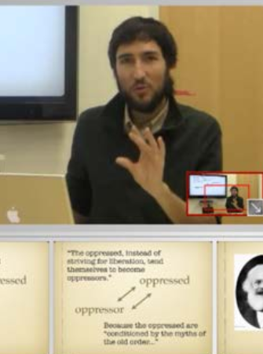
Why they are running MOOCs? What are their issues?
Extend reach and access
Build and maintain brand
Reduce costs, raise revenues
Improve educational outcomes
Research and innovation in teaching and learning
http://cbcse.org/wordpress/wp-content/uploads/2014/05/MOOCs_Expectations_and_Reality.pdf
Notes:
MOOCS: Expectations and Reality Devayani Tirthali, Fiona M. Hollands, Teachers College Columbia University, May 13, 2014 Commentary by Stephen Downes
Longish report (211 page PDF) about the use and understanding of MOOCs in an institutional context. "Through interviews with 83 administrators, faculty members, researchers, and other actors from 62 different institutions (see Appendices I, III and VI for details) active in the MOOCspace or more generally in online learning, we observed that colleges and universities have adopted several different stances towards engaging with MOOCs and are using them as vehicles to pursue multiple goals."

Slide 8
Meanwhile, the denials that cost is even a problem
“the benefits of college still outweigh the costs”
“financial aid programs drive college prices higher”
Student debt overstated
http://www.ny.frb.org/research/current_issues/ci20-3.pdf
http://www.aei.org/events/2014/06/25/policies-to-puncture-the-student-loan-bubble/
http://www.nytimes.com/2014/06/24/upshot/the-reality-of-student-debt-is-different-from-the-cliches.html
Notes:
A Slew of Studies, Summarized Doug Lederman, Inside Higher Ed, Jun 25, 2014 Commentary by Stephen Downes
The general trend of these three studies reported on in this article is that the cost of higher education isn`t such a barrier to poor people as we thought. The undertone to all three is that they are based on hedges and misleading statistics. The studies show, respectively that: college is still worth it, student aid is harmful, and student debt is overstated. The first result, though, is based on the idea that opportunity cost is lower due to the bad economy. The second blames rising tuition on aid programs. The third is based on a small biased sample of rich people. The sort of question I ask when I see this is: what's motivating these studies?

Slide 9
We’re told outright that money is not the problem
“This challenge is much more than an incremental program here or some fine-tuning there; it involves a culture change in how we all take more accountability for educational outcomes.” (BMO Financial Group)
http://www.theglobeandmail.com/news/national/education/education-lab/more-money-wont-fix-need-for-change-in-education/article19309812/
Notes:
More money won’t fix need for change in education Kevin G. Lynch, Globe, Mail, Jun 26, 2014 Commentary by Stephen Downes
Kevin G. Lynch, vice-chairman of the BMO Financial Group, writes in the Globe and Mail: "When discussing the challenges facing the education system in Canada, we often seem to accept the false premise that the only problem is funding... This challenge is much more than an incremental program here or some fine-tuning there; it involves a culture change in how we all take more accountability for educational outcomes." It may be true that more money alone won't improve our educational system, but it would be wrong to infer that the system can be improved without making the investment up front. As bankers well know, it takes money to save money.
“We cannot economically afford today’s high-school drop out rates of almost 8 per cent; we cannot socially afford or condone the low educational attainment outcomes among Aboriginal youth; we cannot expect good educational choices by students unless we provide earlier and better information about them; and we cannot sustain a one-size-fits-all education approach in a complex modern economy.”

Slide 10
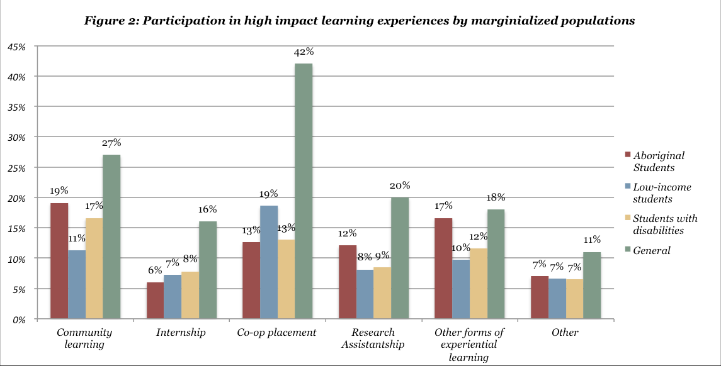
But for many, cost is the problem
“In general, university participation rates are lower among aboriginals, students with disabilities, and the poor.”
http://www.ousa.ca/2014/06/10/experiential-learning-opportunities-created-equal/
Notes:
Are All Experiential Learning Opportunities Created Equal? Ailsa Bristow, Ontario Undergraduate Student Alliance, Jun 12, 2014 Commentary by Stephen Downes
Co-op learning and work placement are good means of ensuring authentic learning experiences, but to be effective they must reach those students who would benefit most from them. This is what is not happening, reports the Ontario Undergraduate Student Alliance. In general, university participation rates are lower among aboriginals, students with disabilities, and the poor. This has a long-term impact on unemployment among these groups. And these differences are magnified for things like co-op placements or paid internships. "Students from marginalized groups are able to secure a WIL (Work-Integrated Learning) opportunity it is less likely to be in a high-quality paid experience, despite the additional financial barriers that students in these groups are more likely to face." Via Academica.

Slide 11
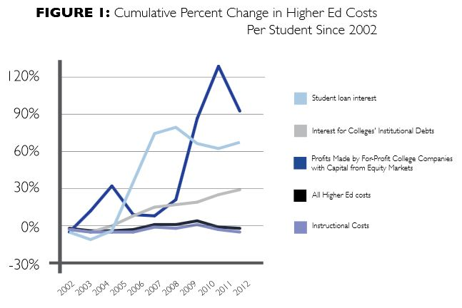
And debt, an even bigger problem
http://www.aft.org/pdfs/highered/BorrowingAgainstFuture0514.pdf
Notes:
Borrowing Against the Future: The Hidden Costs of Financing U.S. Higher Education Charlie Eaton, Cyrus Dioun, Daniela García Santibáñez Godoy, Adam Goldstein, Jacob Habinek, Robert Osley-Thomas, The Center for Culture, Organizations, and Politic, , Jun 19, 2014 Commentary by Stephen Downes
A large part of the imperative for a rethink of the university system is the impact of the costs of that system on society at large. On a personal level, this is represented by the student loan payments that dogged me well into my 40s. But the drain on society is even larger. As George Siemens tweets, quoting from this report, "The largest 15 for-profits [universities] received between 66% and 94% of their revenue from the federal government." Combine this with the fact that they preferentially serve the well-connected and well-to-do, and with the enormous cost of the system as a whole, and you have a mandate for change. That's what this report is about.

Slide 12
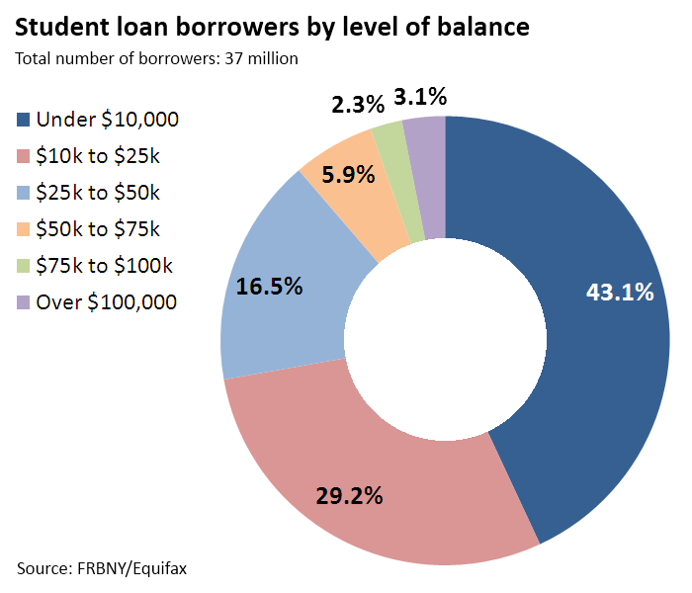
Not only students are hurt, so are their families
“the data suggests parents are borrowing more, going back to work, or dipping into their retirement savings in order to financially support their children’s education”
http://www.casa-acae.com/wp/wp-content/uploads/2014/06/CASAJune5th-NewDataCostEducation.pdf
Image: http://tcf.org/blog/detail/graph-student-debt-the-trillion-dollar-threat-to-the-american-middle-class
Notes:
New Data Suggests the High Costs of Education is Hurting Families Jonathan Champagne, Canadian Alliance of Student Associations, Jun 09, 2014 Commentary by Stephen Downes
According to this survey from the Canadian Alliance of Student Associations, "The high cost of tuition and housing is not only straining students’ budgets, but it is also requiring major sacrifices on the part of families." This is consistent with a steady stream of reports on the impact of the cost of education. This in large part explains why there is such a demand for effective open online learning. Related: another initiative to crowdfund university projects and programs, in another crowdfunding silo.

Slide 13
Meanwhile, the benefits of digital resources never materialized…
11 publishers are raising their prices all at the same time. "Publishers insist, however, that there was no conspiracy to raise prices and that the previous cost model for e-books wasn’t sustainable.”
http://chronicle.com/article/College-Libraries-Push-Back-as/147085/ Image: http://www.dailytech.com/Amazon+Flexes+Its+Muscles+to+Punish+Unruly+Publisher+Hatchette/article34968.htm
Notes:
College Libraries Push Back as Publishers Raise Some E-Book Prices Avi Wolfman-Arent, The Chronicle of Higher Education, Jun 27, 2014 Commentary by Stephen Downes
11 publishers are raising their prices all at the same time. "Publishers insist, however, that there was no conspiracy to raise prices and that the previous cost model for e-books wasn’t sustainable. 'We had absolutely no knowledge and we weren’t advised by the aggregator at all that other publishers were making a change at the same time,' says Rebecca Seger, director of institutional sales for the Americas at Oxford University Press." Not surprisingly, there is tension and mistrust between academic libraries and publishers.

Slide 14
That’s one cost even universities agree is a problem
“Journals published by non-profit organisations were two to 10 times better value than those published by commercial companies, such as Elsevier, Springer, Sage, and Taylor & Francis.”
http://www.theguardian.com/science/2014/jun/16/universities-get-poor-value-academic-journal-publishing-firms
Notes:
Universities 'get poor value' from academic journal-publishing firms Ian Sample, The Guardian, Jun 17, 2014 Commentary by Stephen Downes
I think we knew this, but the secrecy of subscription contracts prevented us from 'knowing' this (in any documented way). But now we have an analysis and "The analysis by a team of economists found that for leading universities, journals published by non-profit organisations were two to 10 times better value than those published by commercial companies, such as Elsevier, Springer, Sage, and Taylor & Francis." I expect the very same is true of learning resources for students as well. Here is the study the Guardian article is based on (might be behind a paywall where you live, natch).

Slide 15
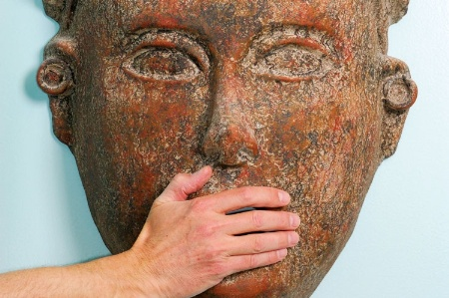
Of course, the journals don’t want to publish this sort of data
… and when they do (only after being threatened with mass resignations) they publish the data with a disclaimer suggesting it is inaccurate
http://www.timeshighereducation.co.uk/news/resignations-threat-over-taylor-and-francis-censorship/2013752.article
The article: http://files.figshare.com/1521805/Publisher__be_damned_.pdf
Notes:
Resignations threat over Taylor & Francis ‘censorship’ Paul Jump, Times Higher Education, Jun 09, 2014 Commentary by Stephen Downes
Another article that suggests publishers aren't simply benign purveyors of academic research, but rather have an interest and engagement in the outcome. Hence this academic paper, which was held back for months, published only after threats of mass resignation, and even then, only published with a large disclaimer stating "the accuracy of the Content should not be relied upon and should be independently verified with primary sources of information." The paper, drawing on an analogy with the music industry, points to excessively high profits taken by academic publishers, suggests that the ineffective Finch Report is mostly the result of industry lobbying, and recommends that academics take a lesson from the Grateful Dead and give their research away, an activity that would not only eliminate publisher profit but result in more, better and cheaper academic research. Here's the article (13 page PDF). Related: Metafilter thread.

Slide 16
So we see calls to recognize alternative forms of literature
‘Grey Literature’
"research and technical reports, briefings and reviews, evaluations, working papers, conference papers, theses, and multimedia content."
http://tebm-libs.wikispaces.com/file/view/Grey+Literature.ppt
http://greyguide.isti.cnr.it/include/pisadeclarationmay2014.pdf
Notes:
Pisa Declaration on Policy Development for Grey Literature Resources Various authors, GreyNet International, Jun 25, 2014 Commentary by Stephen Downes
'Grey literature' is not my favourite term but it will do for now I guess. It includes "research and technical reports, briefings and reviews, evaluations, working papers, conference papers, theses, and multimedia content." In other words, just about every publication related to research that is not a formal academic publication. The Pisa Declaration referred to here is a "call for increased recognition of grey literature’s role and value by governments, academics and all stakeholders, particularly its importance for open access." I'm not sure why a declaration is needed for this but I can't say I disagree with it. I wish it didn't feel like marketing for the 'Grey Guide' report. More at GreyNet.

Slide 17
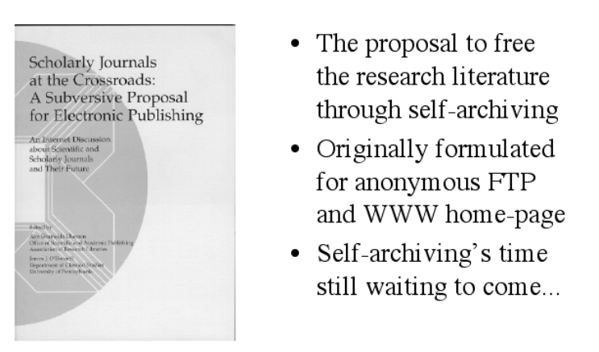
20 years ago: the “subversive proposal”
http://users.ecs.soton.ac.uk/harnad/Tp/Milestones/sld001.htm
http://poynder.blogspot.ca/2014/06/the-subversive-proposal-at-20.html
Notes:
The Subversive Proposal at 20 Richard Poynder, Open, Shut?, Jun 30, 2014 Commentary by Stephen Downes
It is really an idea for its time, I think. "Twenty years ago yesterday, cognitive scientist Stevan Harnad posted a message on a mailing list, a message he headed “A Subversive Proposal”.... Today the Subversive Proposal is viewed as one of the seminal texts of the open access movement."

Slide 18
The growth of a movement
“What drives (Subbiah) Arunachalam is a firm belief that open access holds out the promise of a faster and more effective system for creating and sharing new knowledge…”
http://poynder.blogspot.ca/2014/06/open-access-in-india-q-with-subbiah.html
http://en.wikipedia.org/wiki/Subbiah_Arunachalam
Notes:
Open Access in India: Q&A with Subbiah Arunachalam Richard Poynder, Open, Shut?, Jun 10, 2014 Commentary by Stephen Downes
Credit where credit is due. "Today the world is awash with OA advocates," writes Ricahrd Poynder, "But it was not always thus." One of those early open access (OA) advocates in India was Chennai-based information scientist Subbiah Arunachalam. "What drives Arunachalam is a firm belief that open access holds out the promise of a faster and more effective system for creating and sharing new knowledge, one, moreover, that will not discriminate against the developing world in the way the current subscription system does." Good interview and kudos to Poynder for making sure it's on the record.

Slide 19
No coincidence that WWW-based was created 20 years ago as well
Hill: “the first accredited school to offer a course over the WWW was the Open University in a pilot Virtual Summer School project in the summer of 1994.”
http://mfeldstein.com/internet-based-online-education-turns-20-summer/
http://faculty.education.ufl.edu/Melzie/Distance/Virtual%20Summer%20School%20Project
Notes:
WWW-based online education turns 20 this summer Phil Hill, e-Literate, Jun 25, 2014 Commentary by Stephen Downes
Though the World Wide Web publicly launched in 1991, it didn't really take off until the fall of 1993 and the invention of the graphical browser. This it became that 1994 marked the start of web-based courses, and hence, 2014 became the 20th anniversary of that event. My first website and first online course (on the logical fallacies) didn't appear until 1995 (gosh! I'm such a newbie) (in the years 1991-93 I was still working with educational MUDs; in the 1980s it was with Bulletin Board Services (BBSs). This post from Phil Hill is mainly a recreation of this paper by Marc Eisenstadt describing the first web-based course, on Cognitive Psychology, offered to 12 students at the Open University. (p.s. this post is also notable for its links to the old Internet Underground Music Archive and to Charles Severance's Internet History and Technology course).

Slide 20
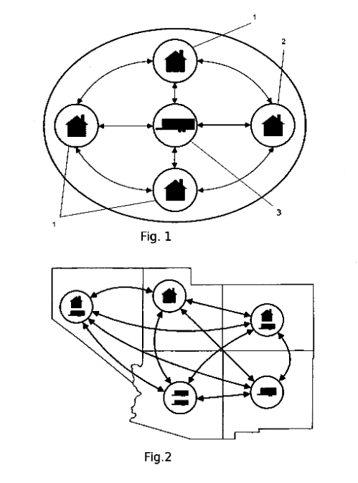
… meanwhile, the benefits of web-based courses were never realized
I once did a quick survey of how long it would take me to get completely caught up reading patent applications in just one area of ed tech. It would be, I discovered, several lifetimes.
http://www.hackeducation.com/2014/06/22/ed-tech-patents/
Notes:
The History of Ed-Tech via Patent Applications Audrey Watters, Hack Education, Jun 26, 2014 Commentary by Stephen Downes
I once did a quick survey of how long it would take me to get completely caught up reading patent applications in just one area of ed tech. It would be, I discovered, several lifetimes. Calling it a 'patent thicket' is an understatement, by far. But this article is a fun read, picking up nine or so influential patents over the years, from the Skinner apparatus for teaching spelling (1866) to Blackboard's Internet-based education support system and methods (1999).

Slide 21
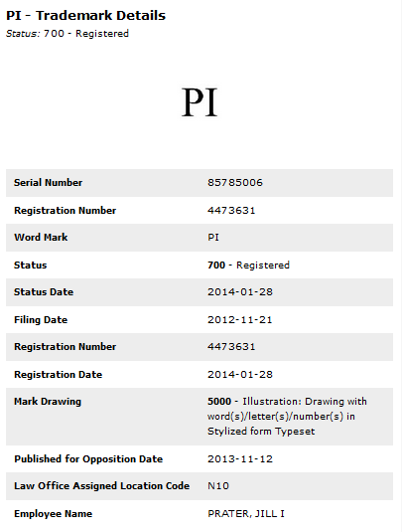
Calling it a ‘patent thicket’ is more than just a slight understatement
It’s way worse than that
http://www.wired.co.uk/news/archive/2014-06/02/pi-trademark-usa
Image: screen capture from http://trademarks.justia.com/857/85/pi-85785006.html
Notes:
Man trademarks Pi, tries to cut out geeky T-shirt designers Kevin Poulsen, Wired, Jun 11, 2014 Commentary by Stephen Downes
I wish I could say that the headline is a joke, but it appears instead to be an all-too-real example of an IP regime gone off the rails. More power to those people ignoring the law and using PI for their own purposes. Oh yeah, and this whole business of using circles in your designs? Cease and desist, I guess?

Slide 22
The phenomenon of enclosure threatens the common heritage we thought we all owned
Study: “... of the 50 titles that had been digitized, only three were hosted by repositories that do not restrict any type of subsequent use”
http://firstmonday.org/ojs/index.php/fm/article/view/4975/4089
Image: http://www.publicdomaintreasurehunter.com/2009/01/10/use-public-domain-short-stories-for-blogs/ (who knows where the original was)
Notes:
Enclosing the public domain: The restriction of public domain books in a digital environment Alex Clark, Brenda Chawner, First Monday, Jun 09, 2014 Commentary by Stephen Downes
Picking up a longstanding discussion I've had with people about enclosure, here's a report from First Monday on how commercial publishers make you pay for resources even through they're free and in the public domain. "Using a sample of 100 pre–1890 New Zealand heritage books... of the 50 titles that had been digitized, only three were hosted by repositories that do not restrict any type of subsequent use. Furthermore, 48 percent (24) were subject to access restrictions." While legally readers may have the right to download and repost public domain works, terms of use make this difficult and risky, as policies are applied and penalties imposed without verification. "The widespread application of usage restrictions upon public domain books is characteristic of an online environment where user agreements and terms of service are ubiquitously imposed as a precondition to access content."

Slide 23
… and it’s going to get worse
Content companies have been creating their own browsers is to be able to implement in-browser digital rights management (DRM) instead of relying on plug-ins like Flash and Silverlight.
https://blog.mozilla.org/blog/2014/05/14/drm-and-the-challenge-of-serving-users/
Image: http://forums.crackberry.com/blackberry-10-apps-f274/amazon-instant-videos-fully-working-browser-849796/
Notes:
DRM and the Challenge of Serving Users Mitchell, Mozilla Blog, May 29, 2014 Commentary by Stephen Downes
One of the reason content companies have been creating their own browsers is to be able to implement in-browser digital rights management (DRM) instead of relying on plug-ins like Flash and Silverlight. Open source browsers, such as Mozilla's Firefox, have no such incentive. However, as the web moves toward built-in DRM, even the open source browsers find themselves having to fall in line. So we move one step closer to the closed web, where you surrender your identity, surrender your choices, and (most likely) pay for the privilege.

Slide 24
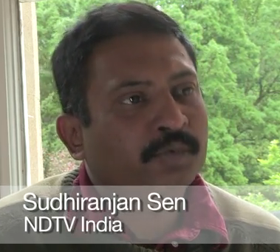
Content providers do not want people to have free and open access
Digital News Report 2014: “We are seeing that the next five years will see a major revenue shift for news agencies. This is especially relevant given the reluctance of people to pay for news.”
http://www.digitalnewsreport.org/
Notes:
Digital News Report 2014 Nic Newman, Reuters, Jun 12, 2014 Commentary by Stephen Downes
The disruptions to news reporting caused by the internet and social media are just beginning, according to this report released by Reuters. Facebook is vital worldwide for news distribution, Twitter in the US, UK and Spain, and WhatsApp in many other parts of the world. Sharing is widespread in the US, Brazil and Spain (though much less so in the UK. So, in related news, we are seeing that the next five years will see a major revenue shift for news agencies. This is especially relevant given the reluctance of pewople to pay for news; "the report finds only a minority of people have paid for digital news in the last year (ranging from 7% in the UK to 11% in the US, 14% in Finland and 22% in Brazil)." As we found here in Moncton last week, a paywall during a crisis looks a lot like profiteering, not service to the community, which has always been the newspaper's core value.

Slide 25
… and their priorities are not our priorities
This includes (especially) universities…
As the University of Alberta searches for a new university president at a minimum $400K salary, at least 56 academics and staff have applied, all in groups of four.
http://www.cbc.ca/asithappens/features/2014/06/06/university-of-alberta-president-salary-letter/
Notes:
Is a 400k salary too much for a university president? Four academics apply to share one lucrative U of Alberta position As It Happens, CBC News, Jun 10, 2014 Commentary by Stephen Downes
A remarkable protest is being made at the University of Alberta. As the University searches for a new university president at a minimum $400K salary, at least 56 academics and staff have applied, all in groups of four. They write, "We believe that by job-sharing this position, we would be able to do a better job than any one person could do - and the salary is certainly ample enough to meet the needs of all four of us." It does raise the question of when a large salary starts being justified, and just represents greed. See also the Edmonton Journal and Inside Higher Ed. Via Academica.

Slide 26
The resistance of academic staff to open content is manifest
Report from the University of Greenwich:
Active change blocking and passive forms of intransigence
Sharing of resources and artifacts happened only on Moodle, which is a closed system
No time to effectively learn about and embed open content
http://terrya.edublogs.org/2014/04/23/greewich-connect-connects-with-us-on-a-number-of-levels/
Report: http://conference.ocwconsortium.org/2014/wp-content/uploads/2014/02/Paper_30.pdf
Notes:
Greewich Connect connects with us on a number of levels Terry Anderson, Virtual Canuck, Apr 27, 2014 Commentary by Stephen Downes
Terry Anderson links to a recent conference paper from the University of Greenwich about an initiative, similar to Athabasca Landing, "designed to induce a variety of open and social programs to the university teaching and learning communities." He reports obstacles similar to those encountered at Athabasca which sometimes "seem intractable." They are:
Resistance manifested itself as both an active form of change blocking and in more passive forms of intransigence
Governance itself became an activity rather than a means to implement activity
Sharing of resources and artifacts happened only on Moodle, which is a closed system
Academic staff felt they had no time to effectively learn about and embed open content
Yeah. So much easier to just assign a $200 textbook and be done with it.
Total: 1609

Slide 27
Even at the Open Textbook Conference, scepticism prevailed
“Adoption by faculty and instructors remains a major challenge. Diane Salter from Kwantlen Polytechnic University stated that there needs to be an institutional strategy…to raise awareness and get buy-in from faculty.”
http://www.tonybates.ca/2014/04/23/what-i-learned-from-the-open-textbook-summit/
Notes:
What I learned from the Open Textbook Summit Tony Bates, online learning, distance edcuation resources, Apr 24, 2014 Commentary by Stephen Downes
(The retired?) Tony Bates attended the Open Textbook summit and came away with five lessons, including this most important one: "Adoption by faculty and instructors remains a major challenge. Diane Salter from Kwantlen Polytechnic University stated that there needs to be an institutional strategy for open textbooks and open educational resources, to raise awareness and get buy-in from faculty." I've had commentators (eg. Jonathan Rees (who has otherwise been very nice to me)) wonder aloud in the past why I sometimes appear so hostile to professors. Well, this sort of thing gets my goat - the overwhelming evidence that the professors don't care, not about student costs, not about institutional costs, not about anything, apparently, except their role as the leaders of academia.

Slide 28
There’s no end of reasons offered to use closed content…
for many disciplines and courses, there is no open textbook available
concerns about quality (e.g., comprehensiveness, clarity, currency, etc.)
no illustrations, charts, or graphics to aid comprehension.
No questions or critical thinking exercises embedded.
No online learning management system available
And, crucially for many faculty, no testbank
choice of textbook is sometimes not an individual one
http://jhangiani.wordpress.com/2014/04/23/a-faculty-perspective-on-open-textbooks/
Notes:
A Faculty Perspective on Open Textbooks Rajiv Jhangiani, Psych prof, living the dream, Apr 24, 2014 Commentary by Stephen Downes
Thanks to a comment from Clint Lalonde on the previous item, I am alerted to this item, which addresses the reasons professors do not use open textbooks. Here is the list, quoted from the article:
for many disciplines and courses, there is no open textbook available
concerns about quality (e.g., comprehensiveness, clarity, currency, etc.)
no illustrations, charts, or graphics to aid comprehension. No questions or critical thinking exercises embedded. No online learning management system available that students can rely on for formative feedback. And, crucially for many faculty, no testbank
choice of textbook is sometimes not an individual one
To me, this is a bit sad. The arguments summed up amount to, "it's easier." Oh my, what did professors do when there weren't publishing companies to do all their work for them. No testbank? Seriously?

Slide 29
Professors who defy the university’s indifference to student costs pay the price
What's key here is that speaking out is being defined as insubordination, and that “everybody is expected to put the good of the whole university ahead of their own interests.”
http://www.cbc.ca/news/canada/saskatoon/prof-robert-buckingham-fired-after-criticizing-saskatchewan-university-plan-1.2642637
Notes:
Prof. Robert Buckingham fired after criticizing Saskatchewan university plan CBC News, May 15, 2014 Commentary by Stephen Downes
It seems to me to be somewhat of an over-reaction to fire a professor and ban him from campus for life for the simple act of speaking out against the administration's plan to save money by merging three university departments (medicine, dentistry, and public health) into one. And when the professor is five weeks from retirement, it just seems vindictive. What's key here is that speaking out is being defined as insubordination, and that "everybody is expected to put the good of the whole university ahead of their own interests." Alec Couros comments, "I can barely stand to follow this story. It makes me very angry, and sad for the the University."

Slide 30
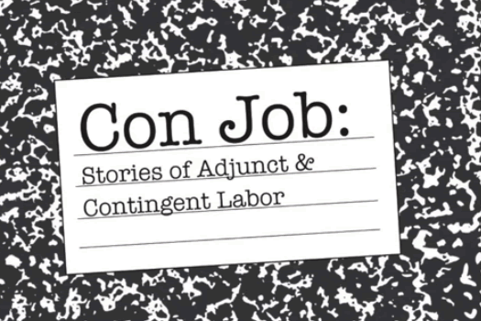
Universities, meanwhile, disguise the unsustainable model by employing poorly paid temporary staff
"Our marginalization, meager pay and lack of job security… all contribute to a culture of paranoia and enmity."
http://drshahsofficehours.wordpress.com/2014/06/05/my-last-day-as-a-professor/
Image: http://www.orderofeducation.com/con-job-new-documentary-adjunct-labor/
Notes:
My Last Day as a Professor Priya J. Shah, Office Hours: gender, feminism in everyday life, Jun 10, 2014 Commentary by Stephen Downes
The praise for academia in the next post notwithstanding, there are things it could do so much better, at least in its North American incarnation, and that is in the employment of adjunct (or in Canada, sessional) instructors. I was in that world for a while. "Our marginalization, meager pay and lack of job security, along with the attacks on professors by students and the administration’s refusal to back up even tenured professors, all contribute to a culture of paranoia and enmity."

Slide 31
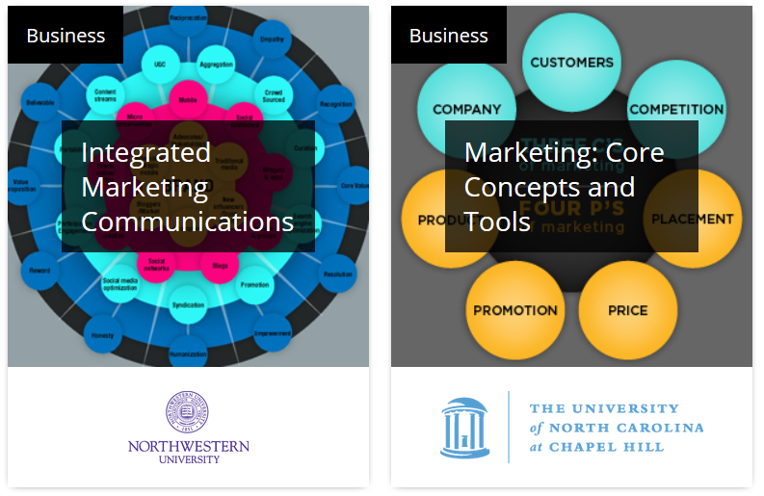
And they priced online learning using the same model they used to price in-class learning
I don't see why university administrators could think that "unapologetically" pricing courses at $1400 per credit hour for online learning could possibly work.
http://www.insidehighered.com/news/2014/05/01/collaboration-or-lack-thereof-behind-semester-online-collapse
Notes:
'We Gave It a Year' Carl Straumsheim, Inside Higher Ed, May 01, 2014 Commentary by Stephen Downes
I don't see why university administrators could think that "unapologetically" pricing courses at $1400 per credit hour for online learning could possibly work. That is all.

Slide 32
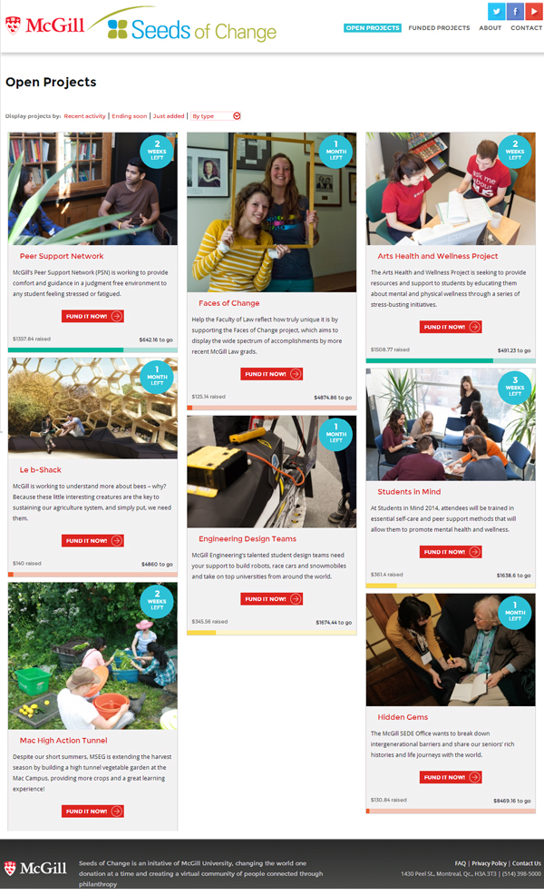
They see new technologies mostly as a means to make more money
For example: McGill University in Montreal has launched a crowdfunding platform to encourage donations.
(Yet again, the silo model prevails)
http://publications.mcgill.ca/reporter/2014/06/seeding-is-believing-mcgill-launches-crowdfunding-platform/
Notes:
Seeding is believing: McGill launches crowdfunding platform Megan Elizabeth Martin, McGill Reporter, Jun 06, 2014 Commentary by Stephen Downes
McGill University in Montreal has launched a crowdfunding platform to encourage donations. "McGill donors can now choose specific projects to support – projects that really speak to them – and watch as their support helps change our landscape of learning," said Ayesha Mayan, Director of McGill’s Annual Fund. So we're moving through a very typical evolution in this technology too - from a single dominant player (Kickstarter) to many individual and silo-style platforms. Next (we can only hope) come the aggregators, which will help us choose from providers.

Slide 33
While the university fundraisers pursue parochial interests, open content advocates create resource networks…
Eg. Confederation of Open Access Repositories (COAR) has undertaken an initiative to align open access repositories.
https://www.coar-repositories.org/files/Aligning-Repository-Networks-Meeting-Report.pdf
Notes:
Aligning Repository Networks Meeting 2014 Various authors, Confederation of Open Access Repositories (COAR), Apr 28, 2014 Commentary by Stephen Downes
The Confederation of Open Access Repositories (COAR) has undertaken an initiative to align open access repositories. This post summarizes the results of a meeting directed toward that objective. "t will give the repository community a stronger global voice and raise the visibility of the role of repositories as critical research infrastructure." 14 page PDF. See also the communiqué.

Slide 34
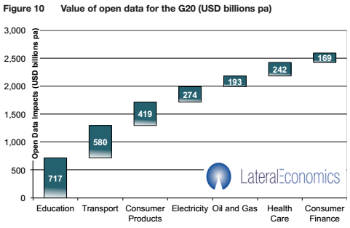
Open access makes a massive economic difference
Ross Dawson: The potential value from open data to the G20 nations is $2.6 trillion annually
http://rossdawsonblog.com/weblog/archives/2014/06/impact-open-data-government-economic-growth.html
Notes:
The massive impact on economic growth of open data in government Ross Dawson, Trends in the Living Networks, Jun 25, 2014 Commentary by Stephen Downes
People sometimes say my push toward open learning is driven by ideology, and there is a bit of that. But it is driven by economics as well, as the value of open education to governments is in the hundreds of billions. And it's the leading edge of a wider benefit that is valued in the trillions. "The major figure from the report is that potential value from open data to the G20 nations is $2.6 trillion annually, or around 1.1% of GDP over the next 5 years. The major sectors where value accrues from open data policies are Education, Transport, Consumer Products, Electricity, Oil and Gas, Health Care, and Consumer Finance." I see this expense as a needless draining of resources from the public purse to private interests, a type of waste far greater in proportion and impact than inefficiency, and probably second only to corruption and war.

Slide 35
Creative Commons: the license is a patch, not a fix – we should be working to a world where the default is open
http://teamopen.cc/thefuture/
Notes:
The Future is Open Various authors, Creative Commons, Jul 03, 2014 Commentary by Stephen Downes
Creative Commons has released their annual report as a picture book. I'm not sure what to think of that. Sure, there's text, but the presentation is mostly visual. The main highlight is the release of version 4.0 of the licenses - we are told they are "global licenses" that don't need to be adapted to each jurisdiction. "The new licenses include provisions related to database rights, personality rights, data mining, and other issues beyond the scope of the original CC licenses." But better is the recognition that "CC licenses are a patch, not a fix, for the problems of the copyright system." This is reflected in a policy statement that urges that content be considered "open by default". Controls on reuse should be the exception, not the rule, and in my view, should require special justification. So much of any creation is borrowed from others there needs to be substantial justification for locking it in its entirety. I guess I don't mind the picture-book format, but posting credits on every page for each image, even the navigation icons, is distracting. Just build a credits page.

Slide 36
And outside formal academia, a world of free and open resources has been unfolding…
Things like Ergo, a free and open journal of philosophy
http://www.ergophiljournal.org/
Image: http://www.aestheticsforbirds.com/2014_05_01_archive.html
Notes:
Ergo Ergo, May 28, 2014 Commentary by Stephen Downes
Most philosophy publications are closed-access, so I haven't really kept up, but this week markes the launch of Ergo, an open-access philosophy journal. "Ergo is a general, open access philosophy journal accepting submissions on all philosophical topics and from all philosophical traditions. This includes, among other things: history of philosophy, work in both the analytic and continental traditions, as well as formal and empirically informed philosophy." Interestingly, the articles in the initial issue are also being blog-commented in the Mod Squad group philosophy blog. None of the articles in the first issue really speaks to me, but I'm hopeful that over time that will improve. Via Certain Doubts.

Slide 37
Things like ‘Mini-Lectures using learning Objects’ by Susan Smith-Nash
“I like this for is simplicity”: Janet Clarey
http://elearnqueen.blogspot.ca/2014/05/mini-lectures-using-learning-objects.html
https://twitter.com/jclarey/status/464781795322781696
Notes:
Mini-Lectures Using Learning Objects: Bosch's The Haywain (1516) Susan Smith Nash, E-Learning Queen, May 09, 2014 Commentary by Stephen Downes
Janet Clarey comments, "I love this for its simplicity." It is a set of mini-lessons offered by Susan Smith Nash, each one small and self-contained, using learning objects the way (I think) they were intended to be used. She writes, "Animated learning objects that bring together images, audio, and interaction are a perfect place to engage students. Now that many translate to HTML5 and are designed to be responsive so that they play well on tablets and smartphones (and on all platforms) as well as laptops, etc., they're a great way to deliver mini-lectures."

Slide 38
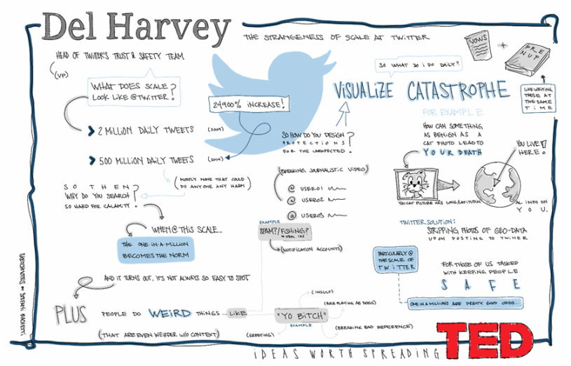
Things like “a new talk, sketched daily” by Kate Torgovnick May
(and even TED, though I once commented that TED is the ‘Upworthy of academia’)
Notes:
A new talk sketched daily, by fan Stefani Bachetti Kate Torgovnick May, TED Blog, May 06, 2014 Commentary by Stephen Downes
I actually like this Tumblr feed featuring a sketch of a new TED talk every weekday (at a certain point the author has to run out of TED talks but that will be a while). I think that what really shows up in these diagrams is the essential similarity between TED talks - the compelling story, the one-line message, a few compelling figures or data sets, the emotional strings. And I am realizing, over time - TED is the Upworthy of academia.

Slide 39
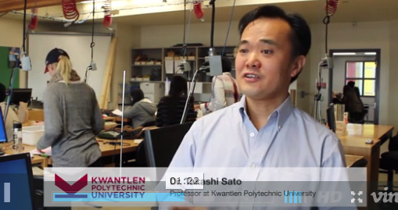
Things like the “Open Textbooks Toolkit” from BC Campus
“Your starting point on how to change education with just one textbook.”
http://open.bccampus.ca/open-textbooks-toolkit/
Notes:
Open Textbooks Toolkit Various authors, B.C. Campus, Apr 28, 2014 Commentary by Stephen Downes
From BCcampus: "The BCcampus Open Textbook Toolkit is your starting point on how to change education with just one textbook. It provides a list of our open textbooks, information and guidelines for adopting and assigning an open textbook."

Slide 40
We are seeing what Martin Weller has called ‘the open virus’…
"It is no coincidence that many of the MOOC pioneers had also been early adopters of open access, active bloggers, and advocates of open licenses. Creating open courses seemed the next logical step…”
http://nogoodreason.typepad.co.uk/no_good_reason/2014/05/the-open-virus.html
Notes:
The Open Virus Martin Weller, The Ed Techie, May 13, 2014 Commentary by Stephen Downes
Though the spread of the open virus is by no means guaranteed, it seems like a natural progression from one domain to the next. "It is no coincidence that many of the MOOC pioneers had also been early adopters of open access, active bloggers, and advocates of open licenses. Creating open courses seemed the next logical step, because they were interested in the possibilities that openness offered and had seen the benefits elsewhere in their practice."

Slide 41
Do we dare imagine a world of open resources beyond ‘courseware’? Beyond the traditional university model?
Maybe. The OpenCourseWare Consortium has changed its name to The Open Education Consortium.
http://www.openedconsortium.org/
Notes:
The Open Education Consortium Mary Lou Forward, The Open Education Consortium, Apr 28, 2014 Commentary by Stephen Downes
By email I learn today that The OpenCourseWare Consortium has changed its name to The Open Education Consortium. Nice new logo and new website. "This change reflects developments in OER and open education and recognizes that the Consortium has broadened its scope of work over the past several years to include support for many types of open education projects around the world," writes Mary Lou Forward. You can also get the procveedings of the (last) OCWC meetings here.

Slide 42
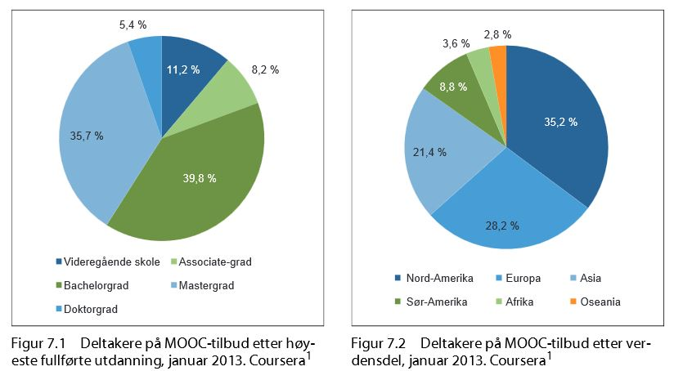
And we are seeing a world-wide embrace of an alternative model of learning based in open content…
A Norway commission recommends a "national investment of up to €16-47 million annually
http://acreelman.blogspot.ca/2014/06/norwegian-mooc-commission.html
The Report: http://ow.ly/ySYSW
Notes:
Norwegian MOOC commission Alastair Creelman, The corridor of uncertainty, Jun 21, 2014 Commentary by Stephen Downes
For those of you who speak Norwegian, the government of Norway has released a commission report on the potential of MOOCs. It recommends a "national investment of up to €16-47 million annually in the coordinated development of online education in the country" which would include the development of a national MOOC platform, MOOCs that lead to course credit, and "inquiry on whether MOOC students should qualify for study loans and grants." An English version of the report is expected soon; meanwhile, this summary provides a good overview in English.

Slide 43
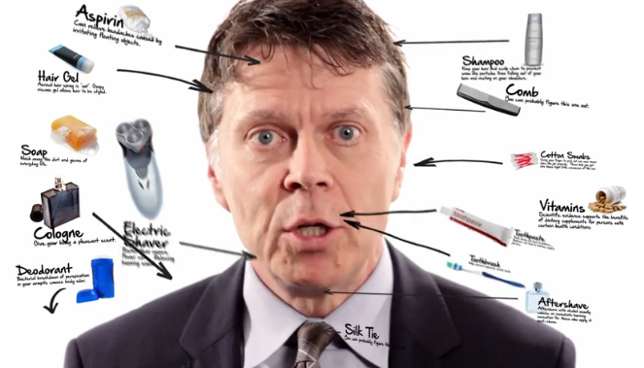
But there’s nothing that can’t be corrupted…
For example: a company that professionally produces five-minute 'educational videos' with the intent of making them go viral (and no, it’s not TED; their videos are longer)
http://chronicle.com/blogs/wiredcampus/online-upstarts-goal-mooc-lectures-that-go-viral/53539 Image: http://mruniversity.com/courses/everyday-economics
Notes:
Online Upstart’s Goal: MOOC Lectures That Go Viral Avi Wolfman-Arent, The Chronicle: Wired Campus Blog, Jun 30, 2014 Commentary by Stephen Downes
I'm not sure how exactly a company that professionally produces five-minute 'educational videos' with the intent of making them go viral qualifies as "upstart" but I guess in some world anything that is not traditional is an upstart. And ooo, radical: "The course is also piloting a call-and-response model where user response drives content: Mr. Boudreaux will add new videos based on the most common questions he receives from students."

Slide 44
The free online lessons can be far from benign
This is from Disney, but the name 'Doc McStuffins' isn't coincidentally the name of a certain fast food place
http://kidscreen.com/2014/04/24/why-disney-is-pushing-further-into-the-preschool-mobile-space/
Notes:
Why Disney is pushing further into the preschool mobile space Jeremy Dickson, iKids, Apr 28, 2014 Commentary by Stephen Downes
If Disney were a benign entertainer (and maybe even educator) of children I wouldn't be so concerned. But one of the risks of a major corporation marketing directly to children is that it becomes the vehicle for even more marketing. Surely, for example, the name 'Doc McStuffins' isn't just coincidentally the name of a certain fast food place that also markets to children. This advertising has long-term impacts (it is interesting to map the advertising on children's 'Superman' radio broadcasts in the late 1940s and early 50s to values expressed in the 60s). What does Disney market? Princesses and rich uncles and an us-versus-them view of the world. And so I'm concerned. As are others.

Slide 45
Don’t think that traditional universities are immune from the temptation. Events have proven that they are not.
Roger Schank: “I am sure, that Stanford itself won’t give the stuff they produce to it’s own students. No one calls this racism (or classism), but it is education for poor people, just as Wal-Mart is focused on poor people. “
http://educationoutrage.blogspot.ca/2014/06/stanford-decides-to-be-wal-mart-doesnt.html
Notes:
Stanford decides to be Wal-Mart; doesn't anyone care about quality education any more? Roger Schank, Education Outrage, Jun 18, 2014 Commentary by Stephen Downes
OK, if this is to be the argument against MOOCs, then universities and their professors are in trouble. Here's the argument: "I am sure, that Stanford itself won’t give the stuff they produce to it’s own students. No one calls this racism (or classism), but it is education for poor people, just as Wal-Mart is focused on poor people. Stanford students won’t eat what Stanford sells to others, but it is selling it like mad to those folks who will never see Palo Alto and will never access a real Stanford education."

Slide 46
On the other hand, Schank’s solution is ridiculous…
$54.5K per year to attend Stanford
x World population ages 20-24 of 596.3M
= a total cost of $32.5 trillion dollars / year.
Or, more money than the total GDP of the G8 nations plus China and India
http://news.stanford.edu/news/2012/february/stanford-undergraduate-tuition-020712.html http://www.census.gov/cgi-bin/broker
https://www.cia.gov/library/publications/the-world-factbook/fields/2195.html
Notes:
Let's ask, for a moment, what it would cost to provide a 'Stanford' education for everyone. It costs about $54.5K per year to attend Stanford as an undergraduate. The world population for ages 20-24 is 596.3M (it's about the same for any 4-year span of people that age). That yields a total cost of $32.5 trillion dollars per year. That's more than the combined GDPs of the G8 nations, plus China and India. There isn't enough money in the world to give everyone a Stanford education. That is why we need cheaper alternatives. Stupid arguments like the one offered here by Roger Schank need not apply.

Slide 47
But it’s hard to resist the idea that MOOCs are moneymaking scams
For example, the Campaign for the Future of Higher Education argues online education "is a billion-dollar business motivated more by profits than quality education for students."
http://campustechnology.com/articles/2014/05/13/are-moocs-a-moneymaking-scam-providers-challenged-to-substantiate-grandiose-claims.aspx
Notes:
Are MOOCs Just Moneymaking Scams? Providers Challenged To Substantiate Grandiose Claims Keith Button, Campus Technology, May 15, 2014 Commentary by Stephen Downes
So the Campaign for the Future of Higher Education has launched a video and campaign against MOOCs, depicting MOOCs as schemes designed to make money. This follows the release of three working papers last year "questioning the basic positive assumptions about online education." I will admit, Coursera, Udacity and EdX make good targets. But it doesn't make sense to tar all MOOCs (and all online learning) with the same brush. More on this item at Inside Higher Ed, Huffington Post, L.A. Times.
If the people at CFHE really want to debate the people behind MOOCs, they should debate George Siemens, Dave Cormier and myself. I for one would stand up and be counted. If they want a real debate, they should give us a call. We're not over-hyped VC-backed straw men you can knock down by citing some overblown rhetoric and fancy videos. We have a couple of decades of smart and steady advances behind us. And we have, I think, a pretty good sense of where we're going in the future, and yes, how the work we're doing with MOOCs and related technology will help provide access to learning for everyone.

Slide 48
And the research is telling us how bad MOOCs really are…
If you are isolated, poor, and enamored of the prestigious university offering the MOOC you’re taking, you are less likely to complete it.
Coaching students to have a healthier mindset about learning may not help in a MOOC.
Paired with the right incentives, MOOCs can help prepare at-risk students for college-level work.
Discussion forums in MOOCs are healthy places for the few students who use them.
We still do not know if doing well in MOOCs will help underprivileged learners become upwardly mobile.
http://chronicle.com/blogs/wiredcampus/5-things-researchers-have-discovered-about-moocs/53585 Report: http://www.moocresearch.com/
Notes:
5 Things Researchers Have Discovered About MOOCs Steve Kolowich, The Chronicle: Wired Campus Blog, Jun 27, 2014 Commentary by Stephen Downes
I think we've learned a lot about MOOCs. And as one of the academics gathered during the Texas snowstorm, I think I can say confidently that these five things are not among them. The five:
If you are isolated, poor, and enamored of the prestigious university offering the MOOC you’re taking, you are less likely to complete it.
Coaching students to have a healthier mindset about learning may not help in a MOOC.
Paired with the right incentives, MOOCs can help prepare at-risk students for college-level work.
Discussion forums in MOOCs are healthy places for the few students who use them.
We still do not know if doing well in MOOCs will help underprivileged learners become upwardly mobile.
Where does the Chronicle say this nonsense comes from? From an organization that should know better. It's not simply that these statements are false (though no doubt some of them are). It's that they're misplaced and emphasized the wrong things. Note that not one of them has anything to do with whether people learn, form communities, or make their lives better.

Slide 49
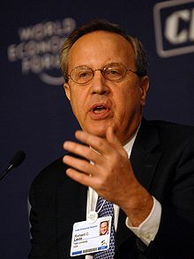
But what sort of MOOC is this research criticizing?
The sort of MOOC created by the same people who wanted to raise money selling courses online – people like Coursera’s Richard Levin, for example…
… who gives us the impression he’s not sure what software like EdX actually does
http://mfeldstein.com/partial-transcript-richard-levin-new-coursera-ceo-charlie-rose/
Notes:
Partial Transcript: Richard Levin (new Coursera CEO) on Charlie Rose Phil Hill, e-Literate, Apr 24, 2014 Commentary by Stephen Downes
Very lightweight interview with Richard Levin by Charlie Rose, with transcript provided by Phil Hill. Maybe Levin is just being cagey, but it's not clear to me he actually knows what the product, the differentiators and the issues are. Like this: "EdX is open source software, which some of the computer science types like that – it means they can play with it, they can add to the features on their own. But we’re developing interfaces that will allow faculty to add features as well." Does he mean modules, apps, APIs (like Coursera just offered)? Does he even know?

Slide 50
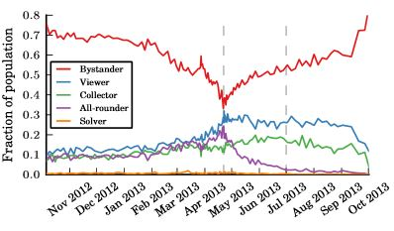
We need to understand that MOOCs are different, that they’re not traditional courses
Drop the lable ‘dropout’ - characterize users by the impact they have on the system: uploaders, commenters, subscribers, viewers, and lurkers.
http://chronicle.com/blogs/wiredcampus/study-of-moocs-suggests-dropping-the-label-dropout/53421?cid=at&utm_source=at&utm_medium=en
Notes:
Study of MOOCs Suggests Dropping the Label ‘Dropout’ Avi Wolfman-Arent, The Chronicle: Wired Campus Blog, Jun 23, 2014 Commentary by Stephen Downes
I'm not a fan of research papers that produce taxonomies, but if you do produce a taxonomy, it should reflect causes, practices, or some such thing. If I were to categorize MOOC users, therefore, I'd characterize them by the impact they have on the system: uploaders, commenters, subscribers, viewers, and lurkers. Each of these can be quantified by site statistics. Meanhile, the best response to this research report is the first comment in the Chronicle: "The fact that anyone ever considered a person who clicked on a link on the internet but failed to devote several weeks of their time to the "product" to be a "dropout" should be the news."

Slide 51
It’s true that one thing that characterises the MOOC is the sheer scale of participation
“the total of 1162 students taking the final exam in this one course is more students than I have taught at Wellesley College over the past ten years”
http://www.insidehighered.com/blogs/higher-ed-beta/alexander-mooc-lands
Notes:
Alexander the MOOC Lands Guy M. Rogers, Inside Higher Ed, May 28, 2014 Commentary by Stephen Downes
I know, it's just another MOOC story, which has been done, but still I can't help passing these sentences along: "Some critics of MOOCs have pointed to the fact that only a small percentage of those who register for MOOCs routinely 'finish' classes... it is true that about 6% of the students who registered for my class completed the final exam. But."

Slide 52
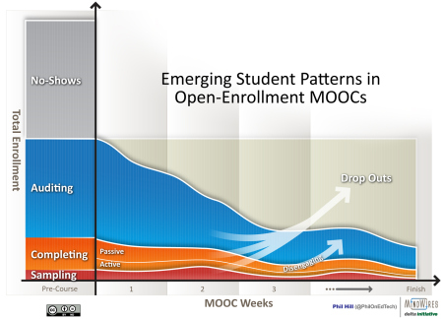
But these numbers do not tell us about the students taking MOOCs
“Did they look at … any information giving a clue on whether students desired to complete the course, get a good grade, get a certificate, or just sample some material?”
http://mfeldstein.com/harvard-mit-learn-university-phoenix-analytics/
Notes:
What Harvard and MIT could learn from the University of Phoenix about analytics Phil Hill, e-Literate, Jun 02, 2014 Commentary by Stephen Downes
Phil Hill is critical of the new data being released by Harvard and MIT from their edX-based MOOCs. "At first I was eager to explore the data," he writes, "but I am not sure how much useful insight is possible due to how the data was collected... this data only tells us very shallow usage patterns aggregated over the entire course – did they look at courseware, how many video views, how many forum posts, final grade, etc. [and] ignores student goals or any information giving a clue on whether students desired to complete the course, get a good grade, get a certificate, or just sample some material."

Slide 53
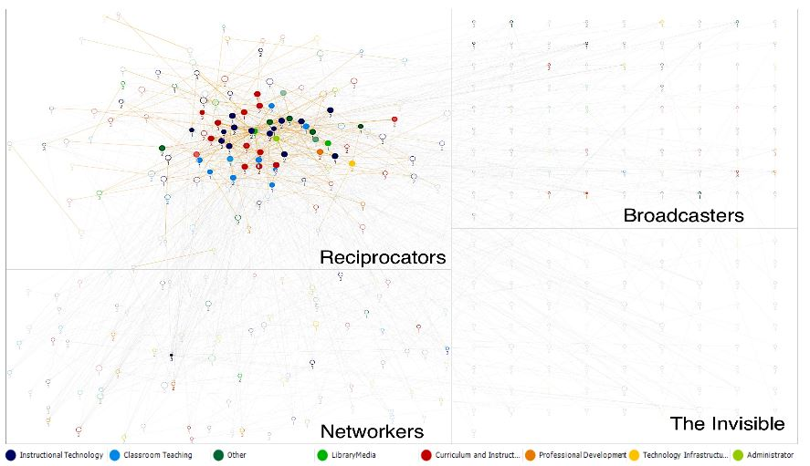
That said, other research shows that the bulk of MOOCs are created in the image of traditional courses… and have unsurprising results
http://www.moocresearch.com/reports
Notes:
MOOC Research Initiative: Reports Released George Siemens, elearnspace, Jun 10, 2014 Commentary by Stephen Downes
George Siemens posts that the reports from the MOOC Research Initiative are now available. There's a disclaimer on the page saying "reports have not been peer reviewed and are provided without comment or assessment regarding research method and outcome" but I read through a dozen of so of them and find the work would be generally acceptable in academic journals (provided they added a 'literature review' section citing previously published works by the journal's editors and reviewers). The focus of the studies was empirical, ranging from an examination of media coverage to analysis of videos viewed to clickstream analysis to network graphs. But for all that many of the MOOCs studied were pretty similar to traditional courses (there are exceptions) and the surveys produce unsurprising results. (Image: Kellogg, Booth and Oliver) Related: Siemens is running a MOOC about analytics on edX this fall (turncoat! ;) ).

Slide 54
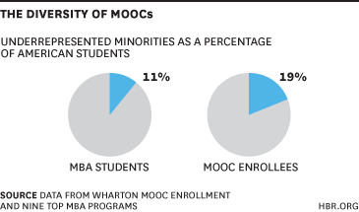
The retrenchment has begun with the assertion that the MOOC will not replace traditional courses
It will only supplement them
But they will diversity them (slightly)
http://blogs.hbr.org/2014/06/moocs-wont-replace-business-schools-theyll-diversify-them/
Notes:
MOOCs Won’t Replace Business Schools — They’ll Diversify Them Gayle Christensen, Brandon Alcorn, Ezekiel Emanuel, Harvard Business Review Blogs, Jun 06, 2014 Commentary by Stephen Downes
This idea here is that MOOCs are effective advertsing vehicles that will help these schools attract the demographics they want, especially since they have a global reach. Of course, this is true for every agency which launches a MOOC, so if everyone launches MOOCs, it's all a wash.

Slide 55
And, of course, traditional education will “absorb” MOOCs
That institutions will simply absorb MOOCs doesn't surprise me - they have very different goals and ambitions from the rest of us.
Bellweather Report: http://bellwethereducation.org/policymakers_guide_to_moocs
Teachers’ College, Columbia University, Report: http://cbcse.org/wordpress/wp-content/uploads/2014/05/MOOCs_Expectations_and_Reality.pdf
Notes:
Conventional Online Higher Education Will Absorb MOOCs, 2 Reports Say Steve Kolowich, The Chronicle: Wired Campus Blog, May 16, 2014 Commentary by Stephen Downes
I think that the most interesting thing about this headline is that it asserts that there is such a thing as 'conventional online higher education'. Even a few years ago the words would have choked in the Chronicle headline writer's pen. So the two reports are from Center on Higher Education Reform at the American Enterprise Institute, which released the Bellwether report, and Teachers College at Columbia University, which released a report cited here the other day. That institutions will simply absorb MOOCs doesn't surprise me - they have very different goals and ambitions from the rest of us. But ask the question differently, and you get a different answer. Will massive open online learning survive? Almost certainly - part of the new reality institutions must now deal with is that free versions of their course materials (or materials very similar to their course materials) will exist online. And institutions won't absorb that. They can't.

Slide 56
The mission has shifted completely away from MOOCs and into support of the university’s prosperity
Richard Levin (Coursera): “The big picture is this magnifies the reach of universities by two or three orders of magnitude.”
http://mfeldstein.com/coursera-shifts-focus-impact-learners-reach-universities/
Notes:
Coursera shifts focus from ‘impact on learners’ to ‘reach of universities’ Michael Feldstein, e-Literate, Jun 25, 2014 Commentary by Stephen Downes
Just to note this, so we don't miss it: "Richard C. Levin, the new chief executive of Coursera [says] the talk of “flipped classrooms” and “blended learning” — weaving MOOCs into classroom experiences — is not mere hype. 'But that is not the big picture,' Levin said in a visit last week to The Washington Post. 'The big picture is this magnifies the reach of universities by two or three orders of magnitude.'" Feldstein comments (cynically?) "It is possible that Levin’s focus will indirectly improve the learning potential of Coursera’s products and services, but it is worth noting a significant change in focus from the largest MOOC provider." See also the Chronicle's coverage of the same announcement; "esearchers at Columbia University published a paper noting that many university stakeholders are unclear about why they are investing in MOOCs." Related: the value of MOOCs to early adopter universities, EDUCAUSE Review.

Slide 57
They want to build a marketplace (and worse, they think it’s a new idea)
“Brilliance struck. We call it Canvas Catalog.”
http://voice.instructure.com/blog/bid/346982/Brilliance-struck-We-call-it-Canvas-Catalog
Notes:
Brilliance struck. We call it Canvas Catalog. Matt Goodwin, Canvas by Instructure, May 30, 2014 Commentary by Stephen Downes
Instructure is launching a new product called Canvas Catalog, "a white-label platform that enables any institution, government entity, university or K-12 school to create a branded index of online courses." This means, according to the blog post, "any organization using Canvas now has the ability to build a marketplace or storefront for their courses. This gives learners the ability to register, enroll, pay (if that’s your thing), and start taking courses without all the typical hassle." What I'd like to see from this service is an RSS feed - free courses should be freely syndicated (here's a sample RSS-Events file and the RSS-Events schema is available here). As usual, the announcement comes before the actual product is available, which is always annoying. So is the whole 'accidental invention' analogy, which in this context (and given the existence already of MOOC catalogues) is ridiculous.

Slide 58
This of course is the next new land rush
http://openeducationeuropa.eu/en/project/emma-0
Notes:
European Multiple MOOC Aggregator Various authors, Open Education Europa, Apr 24, 2014 Commentary by Stephen Downes
Worth a look: "EMMA will provide a system for the delivery of free, open, online courses in multiple languages from different European universities to help preserve Europe’s rich cultural, educational and linguistic heritage and to promote real cross-cultural and multi-lingual learning."

Slide 59
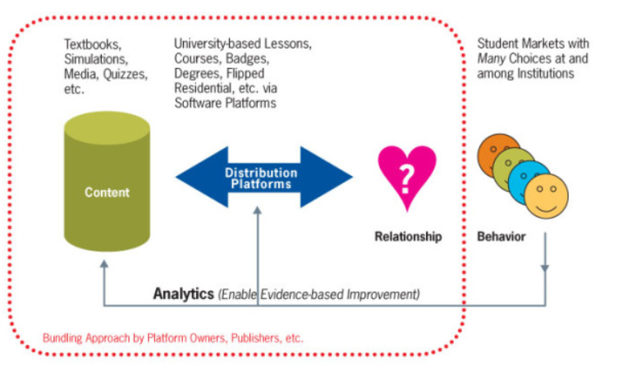
*sigh* … Unizin
“…coalition of interdependent universities to provide an LMS, content repository, and learning analytics system.”
http://mfeldstein.com/unizin-threat-edx/
Notes:
Why Unizin is a Threat to edX Michael Feldstein, e-Literate, May 27, 2014 Commentary by Stephen Downes
e-Literate a week or so broke a story on Unizin, an initiative from the Indiana University designed to, as Michael Feldstein says, "run the table" on online learning technologies. In this post he adds more; it's an oddly personalized look at the initiative: "If you want to understand Unizin, you really have to understand Brad Wheeler.... Unizin has his fingerprints all over it." Well, maybe. "The LMS + MOOC pitch explains why these universities might be interested in a coalition, but it doesn’t fully explain the interest in the Learning Object Repository and analytics system." Really? We couldn't understand these without understanding Brad? Anyhow, do ready these articles - the field of education technology is in a rapid state of flux right now.

Slide 60
Why this is important: MOOCs are not second rate and they are not disappearing of being absorbed or anything else.
Yes, they are ‘disruptive’ – “their potential to disrupt — on price, technology, even pedagogy — in a long-stagnant industry is only just beginning to be seen."
http://www.bostonglobe.com/opinion/2014/05/09/moocs-disruption-only-beginning/S2VlsXpK6rzRx4DMrS4ADM/story.html
Notes:
MOOCs’ disruption is only beginning Clayton M. Christensen, Michelle R. Weise, Boston Globe, May 12, 2014 Commentary by Stephen Downes
What characterizes a bubble isn't the chorus of sceptics. It's thee lack of them. So MOOCs - who have certainly attracted the sceptics - are far from the bubble stage of their existence. So say Clayton M. Christensen and Michelle R. Weise in this op-ed. "Undoubtedly pronouncements over MOOCs’ demise are likewise premature. And their potential to disrupt — on price, technology, even pedagogy — in a long-stagnant industry is only just beginning to be seen."

Slide 61
The ‘disruptive’ in MOOCs is not size or pedagogy or even internet (though all are changed) – it’s that they are free and open
(The one thing universities have struggled with)
The idea of a national networks for free learning is something that can endure, and eventually, become entrenched.
http://www.npr.org/blogs/ed/2014/05/29/316989869/the-future-of-online-ed-isnt-heading-where-you-expect
Notes:
The Future Of Online Ed Isn't Heading Where You Expect Anya Kamenetz, NPR, May 30, 2014 Commentary by Stephen Downes
Short article with what is (I think) important news: "Trinidad and Tobago. Its government this week announced the creation of a National Knowledge Network to promote free online learning in partnership with Khan Academy and Coursera." I think we can ignore the bit about the providers - these can change over time, while the idea of a national networks for free learning is something that can endure, and eventually, become entrenched. We've been seeing a number of stories like this, as the proprietors of these providers work their political connections to get national announcements.

Slide 62
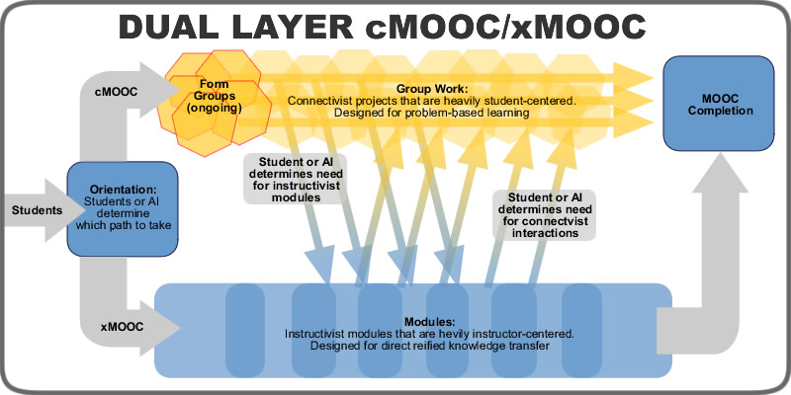
We’re beginning to see the importance of this in Matt Crosslin’s efforts to design a ‘hybrid’ MOOC
The idea of ‘free and open’ is linked to the importance of dialogue and interaction
http://www.edugeekjournal.com/2014/05/04/designing-a-dual-layer-cmoocxmooc/
http://www.edugeekjournal.com/2014/06/07/communal-constructivism-and-dual-layer-moocs/
Notes:
Designing a Dual Layer cMOOC/xMOOC Matt Crosslin, EduGeek Journal, May 06, 2014 Commentary by Stephen Downes
Honestly, I don't know why you'd want to design a 'dual layer cMOOC/xMOOC' - but let's listen to the proposal. "At any time that the learners on the cMOOC track need help (or at some point, when the AI data identifies a need), they can be directed towards the appropriate part of the xMOOC track for help. At any time the learners on the xMOOC track start to get comfortable with the idea of interacting with others (or the AI data identifies this), they can move into the cMOOC track." Or - we could just seed the discussion with learning resources on an ongoing basis, as appropriate.

Slide 63
But why design a hybrid?
"Normative communicative actions are those that communicate knowledge based on past experiences…
"Strategic communicative actions … where specific reified knowledge is transferred to the learner.
"Constative communicative actions are debates, arguments, and discourses …
"Dramaturgical communicative actions are those that allow for expression…”
http://www.edugeekjournal.com/2014/05/07/why-design-a-xmooc-cmooc-hybrid-ltca-theory/
Notes:
Why Design a xMOOC / cMOOC Hybrid? LTCA Theory Matt Crosslin, EduGeek Journal, May 08, 2014 Commentary by Stephen Downes
Matt Crosslin follows up an earlier post with an explanation of why he thinks it would be a good idea to build a cMOOC/xMOOC hybrid. He writes, "the idea of MOOC layers is really looking at a four pronged approach to the idea of teaching and learning as communicative actions using LTCA theory." This theory, he writes, is being created by Scott Warren at North Texas, based Jurgen Habermas, and breaks learning down in to four majopr activities, some of which are subsumed by xMOOCs and some by cMOOCs. To quote Crosslin at length:
"Normative communicative actions are those that communicate knowledge based on past experiences, such as statements in class instructions that lay out expectations for student activities.
"Strategic communicative actions are the most familiar educational communicative actions – these occur most often through lectures, textbooks, and other methods where specific reified knowledge is transferred to the learner.
"Constative communicative actions are debates, arguments, and discourses that allow learners to make claims and counterclaims. Constative communication is also where social constructivism connects with LTCA theory, as students come to agreement over constructed knowledge through these communicative actions
"Dramaturgical communicative actions are those that allow for expression. Learners can reflect or create artifacts that express the knowledge they have gained as well as who that knowledge makes them as a person."
For my part, I don't think that taxonomies make good theory. Yes, if we look at the full range of existing practice, we see these forms. But what would we see if we looked only at (say) effective practice?

Slide 64
Let’s build mesh networks of people instead…
“What could we actually do on limited budgets that might help people and that we can share, for other people to take and run with to solve their own local issues?”
http://cogdogblog.com/2014/05/08/mesh-networks-of-people/
Notes:
Mesh Networks of People Alan Levine, CogDogBlog, May 09, 2014 Commentary by Stephen Downes
I think that the more you get out and talk with people the more you find these deep mesh networks of people around domains, ideas, disciplines and hobbies. As Alan Levine says, "connections I make, not just PLNing or linking online, just by talking and listening… are gold." What's also interesting - I was just at a meeting this morning where I experienced the same sort of thing - is that these networks recede off into the distance; you can get a grasp of some of those around you, you can see them stretch off into the horizon, but the totality of them all is something you can only partially grasp, and you could spend your life exploring. This is what Levine has been doing over the last few years (and he is thus being afforded a genuinely unique view of the world). And significantly, what he sees - I think (it's what I see, at least) - is that this is how human society is structured, and the hierarchies and institutions and more visible elements of society are just an overlay, artificial abstractions, formalisms, artifacts we create, but not ultimately core or significant. Levine has some excellent examples in this post which make it worth a look.
P.S. see also Levine on changes to the Flickr API and on how Twitter is a crappy RSS reader replacement. "Twitter is no replacement for the ability to quickly scan a reliable set of sources that collect the drops while away."

Slide 65
Open content + conversations = learning networks
The Aboriginal Enhancement Schools Network (AESN) in British Columbia, Canada, “offers a powerful example of how teacher learning networks can enable deep and transformational change”
http://ineducation.ca/ineducation/article/view/136
Image: http://www.jenniferannaispighin.com/apps/photos/photo?photoid=58051954
Notes:
Disrupting Colonial Mindsets: The Power of Learning Networks Catherine McGregor, In Education, May 16, 2014 Commentary by Stephen Downes
This paper offers an example of "how one particular teacher-learning network—the Aboriginal Enhancement Schools Network (AESN) in British Columbia, Canada, offers a powerful example of how teacher learning networks can enable deep and transformational change among participating teachers and leaders." It merges the concept of the community of practice with the need for non-hierarchal and inclusive leadership. From Sachs: "The activist teacher professional creates new spaces for action and debate, and in so doing improves the learning opportunities for all of those who are recipients or providers of education”

Slide 66
The old idea that professors tell students what to believe is wrong… and we are learning more about how students learn from each other
For example: “interaction with diverse views … causes students to moderate their political views.”
http://www.insidehighered.com/news/2014/06/10/study-finds-students-themselves-not-professors-lead-some-become-more-liberal-college
Notes:
Stop Blaming Professors Scott Jaschik, Inside Higher Ed, Jun 10, 2014 Commentary by Stephen Downes
This study makes me wonder what's happening outside campus. In a nutshell, it suggests that interaction with diverse views through engagement with academics causes students to moderate their political views, while interaction with similar views through student groups causes them to radicalize their views. So what happens in, say, a Wall Street brokerage, where everyone has the same political view? Oh yes, there's a lot of indoctrination going on out there, and to point the finger at institutes of higher learning, where it is least likely to occur, has always struck me as absurd.

Slide 67
Principles for dynamic networks …
Deleuze and Guattari (D & G) enumerate 6 approximate characteristics of the rhizome, including:
Connections
Heterogeneity -
Multiplicity
Asignifying rupture
5 & 6. Cartography
http://jennymackness.wordpress.com/2014/06/24/principles-for-rhizomatic-thinking/
Notes:
Principles for Rhizomatic Thinking Jenny Mackness, Jun 27, 2014 Commentary by Stephen Downes
"Deleuze and Guattari (D & G) enumerate 6 approximate characteristics of the rhizome. The principles are: 1. Connections – a rhizome ceaselessly establishes connections. 2. Heterogeneity - any point of a rhizome can be connected to any other and must be. 3. Multiplicity – A multiplicity is, in the most basic sense, a complex structure that does not reference a prior unity. Asignifying rupture. If you break a rhizome it can start growing again on its old line or on a new line. 5 & 6. Cartography and decalcomania – the rhizome is like a map and not a tracing."

Slide 68
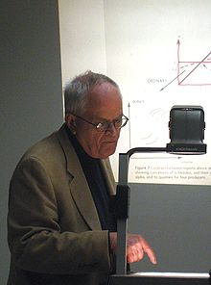
Social networks as seen by Harrison C. White…
"Social life is made up of endless chains and multiple overlapping nets, with no clear boundaries. It is long stings .... It is only a messy mesh or, rather, mush. Social reality is a terrain, a typology of networks and chains."
http://citeseerx.ist.psu.edu/viewdoc/download?doi=10.1.1.195.3584&rep=rep1&type=pdf
Notes:
The Basic Framework in the General Sociology of Harrison C. White Reza Azarian, Stockholm University, May 11, 2014 Commentary by Stephen Downes
While writing my posts over the last few days I had occasion, thanks to a tweet, to look up a number of works by and about Harrison White. It's not an understatement to say that a lot of what I say is anticipated years earlier in his work. "Social life is made up of endless chains and multiple overlapping nets, with no clear boundaries. It is long stings .... It is only a messy mesh or, rather, mush. Social reality is a terrain, a typology of networks and chains."
I like what I've seen of White a lot, and it is not surprising to me to read in this interview that he was a friend to Herbert Simon (of Newell and Simon). The major statement of White's thesis can be found in his book Identity and Control. "White replaces person with identity, which, in a distinctively human sense, emerges from frictions and social noise across different levels and disciplines in networks. Likewise he reshapes the notion of goals, maintaining that they merely inhabit sets of stories used to explain agency."

Slide 69
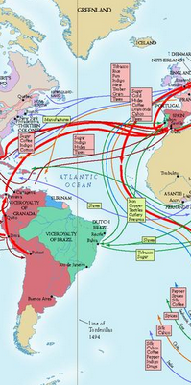
The structure of the MOOC is the structure of the network; the principles of the MOOC are the principles of the network
Explanations stem from analyses of patterns of relations… the autonomy of entities in the network, and … strong and weak ties
http://citeseerx.ist.psu.edu/viewdoc/download?doi=10.1.1.130.1129&rep=rep1&type=pdf
Notes:
Trading routes, bypasses, and risky intersections Gernot Grabher, University of Bonn, May 11, 2014 Commentary by Stephen Downes
I found a lot of good stuff in this paper, which I found while looking for a combination of Harrison White and Actor Network Theory. Part I.1 has a nice summary of the history of the distinction between groups and networks. Part II.1 talks about network governance and II.5 talks about informal networks. Part II.1 takes what I consider to be the key network 'turn', from network content to network structure. "Explanations stem from analyses of patterns of relations." III.3 talks about the autonomy of entities in the network, and III.4 talks about strong and weak ties. III.5 ties this explicitly to the 'small worlds' theory. In section IV we see the "promising turns" and a discussion of rhizomes, ANT and related issues. Finally, in section IV.3 Harrison White is presented as a softer alternative to ANT: "following White’s path allows us to unlock the actors from the rigid grid of homogenous ties and to place them in the fluid context of an entire spectrum of network domains."

Slide 70
Optogenetics, connections and the diversity of the neural network
“There’s no such thing as a generic neuron,” says Anderson, who estimates that there may be up to 10,000 distinct classes of neurons in the brain.
http://www.technologyreview.com/featuredstory/528226/neurosciences-new-toolbox/
Notes:
Neuroscience’s New Toolbox Stephen S. Hall, MIT Technology Review, Jun 18, 2014 Commentary by Stephen Downes
Optogenetics is a really cool way of studying neural networks. Inset a light-sensitive gene into selected neurons, then turn on a fibre-opting light, activating the neutron, and watch what happens. The current study is about aggression, but I like what the researcher says about diversity: "“There’s no such thing as a generic neuron,” says Anderson, who estimates that there may be up to 10,000 distinct classes of neurons in the brain. Even tiny regions of the brain contain a mixture, he says, and these neurons 'often influence behavior in different, opposing directions.'"

Slide 71
Far from curriculum, we should be emphasizing diversity, experience and autonomy in learning
http://www.macleans.ca/society/health/bringing-mindfulness-to-the-school-curriculum/
Notes:
Bringing mindfulness to the school curriculum Kate Lunau, MacLean's, Jun 18, 2014 Commentary by Stephen Downes
I don't think the authors at MacLeans really approve (they raise the criticism that some parents (and teachers) worry the practice of meditation is akin to bringing religion into schools) but they nonetheless carry this interesting story about the teaching of meditation (called 'mindfulness', and yoga (called 'stretching')) in schools. I see nothing wrong with it; I was taught several religions in school, including hockey, basketball and football. Ultimately, it has to be left to the students' discretion as to whether to continue the practice, after an appropriate period of instruction. But I have no doubt this is the school's policy.

Slide 72
The idea of the MOOC is not just the idea of open resources, or even open teaching … it’s about living openly
It’s not about teaching it’s about sharing the process of thought and inference and discovery with those around you
http://mdvfunes.com/2014/05/25/the-psychology-of-open-on-wrestling-your-inner-mooc/
Notes:
The psychology of open: On wrestling your inner MOOC Mariana Funes, doublemirror, May 27, 2014 Commentary by Stephen Downes
You can't be half open, says Mariana Funes, but it's a process, and you can adapt to it. "Work at your own pace, do not let anyone force you into openness online faster than you are ready for it. Ultimately in becoming an open educator your are making a choice to relinquish some of your privacy and control of where your work goes in order to share it with others." Good longish post - summary notes for a MOOC presentation - that delves into the experience of being open. Via Alan Levine.

Slide 73
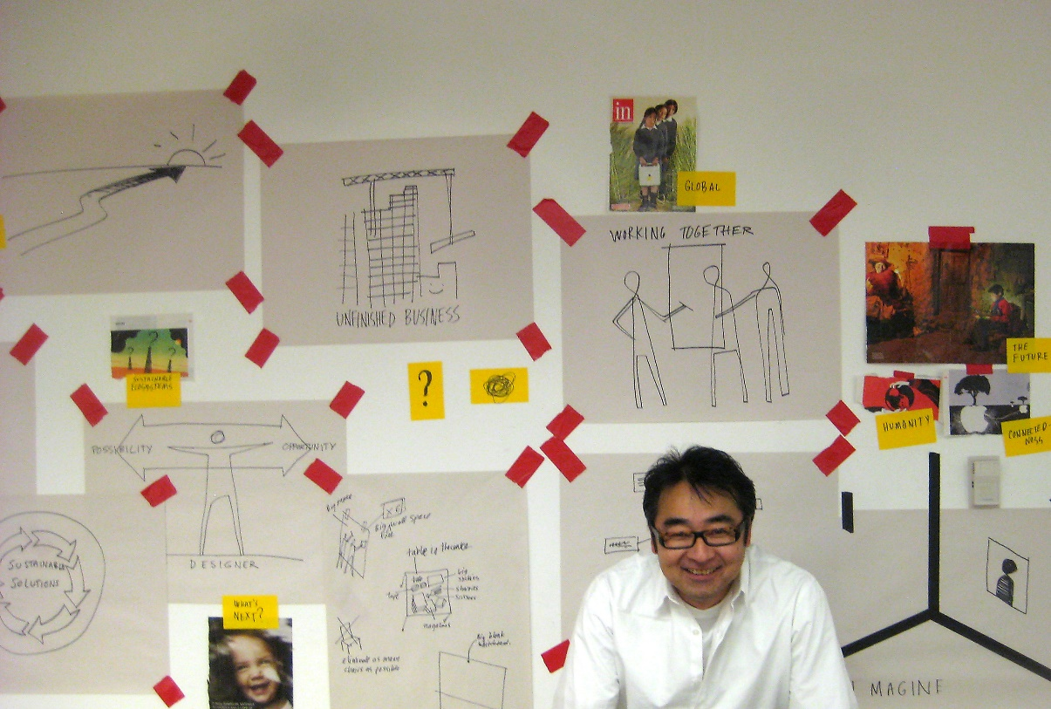
Sharing with things like…
BoardThing
“Create cards with text or images. Move and arrange cards with collaborators on a shared board.”
http://boardthing.com/
Notes:
BoardThing BoardThing, May 27, 2014 Commentary by Stephen Downes
BoardThing looks like an organized person's Pinterest: "Create cards with text or images.Move and arrange cards with collaborators on a shared board. Organize cards into groups.Export your board as HTML, plain text, or outline (OPML)." It's still in private beta; I've asked for an invite and if it proves interesting I'll report back.

Slide 74
Things like…
MOOCopoly, the game
Alan Levine: “I came across a Monopoly template in Photoshop," he writes, "found within a 2008 blog post by Brad Frost. Yep, a self hosted blog strikes again.”
http://cogdogblog.com/2014/05/03/moocopoly-the-game/
Notes:
MOOCopoly: The Game Alan Levine, CogDogBlog, May 05, 2014 Commentary by Stephen Downes
Just for fun (and as part of the Daily Create challenge 486 - make a board game) Alan Levine created this fun version of MOOCopoly. "I came across a Monopoly template in Photoshop," he writes, "found within a 2008 blog post by Brad Frost. Yep, a self hosted blog strikes again. This is quite the template; every element of text on the board is editable; and he even provides fonts. He apologizes a bit for much about how much is left out, but it is cleanly organized into folders within the layers palette, and was super easy to modify." I like how you pay $12 to land on ds106 - whether it has one, two, three or four houses (I guess if there's a hotel the Bava's at a conference).

Slide 75
The future of open is decentralized - that’s why it is being opposed
“As a consequence, though, of this clampdown we are seeing the rise of genuinely distributed networks that circumvent attempts at control - things like BitTorrent, Bitcoin, DarkMarket, and now, MaidSafe, which allows users to share bandwidth and processing power”
http://www.dailydot.com/technology/decentralized-internet-future/
Notes:
The future of the open Internet is decentralized Joseph Cox, The Daily Dot, May 12, 2014 Commentary by Stephen Downes
Many of the recent problems being seen in digital communications - from the cost of acess to the widespread spying to the blocking of services like YouTube and Twitter to the commodification of commercialization of services that used to be free - have resulted from the ongoing re-centralization of the internet, where one or a few services are able to monopolize discourse. This has not resulted (as they say) naturally, but as the result of the deliberate intervention by corporations and governments to make the internet manageable. As a consequence, though, of this clampdown we are seeing the rise of genuinely distributed networks that circumvent attempts at control - things like BitTorrent, Bitcoin, DarkMarket, and now, MaidSafe, which allows users to share bandwidth and processing power to support a distributed and very underground applications network.

Slide 76
That’s why internet access is being sold to the highest bidder
But, of course, it’s not just the internet – it’s our decentralized and common system of laws and values
Thus, the US FCC votes to end net neutrality
https://medium.com/p/7805f8049503
Image: http://noarmycanstopanidea.com/everything-you-need-to-know-about-the-end-of-net-neutrality/
Notes:
How the FCC Plans to Save the Internet By Destroying It: An Explainer Ryan Singel, Medium.com, Apr 26, 2014 Commentary by Stephen Downes
Everybody and their dog has already covered the FCC's recent decision to end net neutrality (their feeble objections notwithstanding). It's a U.S. decision but as we know once enshrined into American law a campaign will then follow to entrench it into world trade legislation, requiring countries to pay penalties for lost profits should they attempt to enact net neutrality, as Brazil has done (just as a Canadian company is demanding $200 million from El Salvador over a mine it was not allowed to build). It will destroy the internet as we know it, reducing it to a set of network-provided pablum services. Just like television. Meanwhile, stuff we need (like education) will be reduced to a crawl, unless governments compensate telecoms for not throttling non-profit and public good internet traffic. Via Hack Education.

Slide 77
The open content movement is beginning to address open policy
Though I wish it adopted a more enlightened strategy
http://openpolicynetwork.org/
Notes:
Institute for Open Leadership Open Policy Network, May 26, 2014 Commentary by Stephen Downes
Are you good enough for open learning? "Who should apply to be an IOL Fellow? Public and private sector professionals interested in openness and policy with the passion and potential to make a high impact at their institution and/or government through open policy*. Emerging leaders in academia, the arts, cultural institutions, government, scientific labs, and others who are eager to become experts in open licensing."
Launch of the Open Policy Network Open Policy Network, May 21, 2014 Commentary by Stephen Downes
The Open Policy Network has now officially launched. Here's their version of open: "we’re announcing our first project, the Institute for Open Leadership. Through a weeklong summit with experts, accepted fellows will get hands-on guidance to develop a capstone project for implementation in their organization or institution." You can join the network but you must "support the Guiding Principles and Work Plan", "participate in the OPN email listserv and share information," and "attend monthly strategy/planning conference calls." It's like joining the Kiwanas Club! Anyhow, here is more information and endorsements from Creative Commons, SPARC, CETIS, OERu.
Open Policy Network Open Policy Network, May 14, 2014 Commentary by Stephen Downes
Creating Commons is launching new Open Policy Network website. More information here. "The mission of the Open Policy Network is to foster the creation, adoption and implementation of open policies and practices that advance the public good by supporting open policy advocates, organizations and policy makers, connecting open policy opportunities with assistance, and sharing open policy information." They're not getting off to a good start on 'open' by imposing a news embargo, which is why I'm breaking it.

Slide 78
We need to be open, not just in the big things, but also in the little things
Embargo periods, for example
https://www.coar-repositories.org/activities/advocacy-leadership/aligning-repository-networks-across-regions/statement-about-embargo-periods/
Notes:
Statement about embargo periods Kathleen Shearer, Confederation of Open Access Repositories (COAR), May 14, 2014 Commentary by Stephen Downes
For a while, supporters of open access have accepted embargo periods as a necessary evil to promote the transition from closed source to open access publications. Embargo periods delay the publication of open versions of paid articles for a period of time. Now they are seeing the cost of that compromise. "Embargo periods dilute the benefits of open access policies and we believe that, if they are adopted, they should be no more than 6 months for the life and physical sciences, 12 months for social sciences and humanities." The coalition of open access repositories that signed the document argues that embargo periods should eventually be eliminated. One wonders about the wisdom of building this compromise into open access policies in the first place.

Slide 79
Open content, open access, open learning… these are not only a part of democracy,
they define democracy, and our system of free and open government depends upon them
http://www.jarche.com/2014/05/a-world-of-pervasive-networks/
Notes:
A world of pervasive networks Harold Jarche, May 05, 2014 Commentary by Stephen Downes
Harold Jarche applies McLuhan's tetrad to the world of pervasive networks. McLuhan's original model (not a 'lens') suggests each new technology has the potential to: first, extend a human property, second, obsolesce a previous technology, third, retrieve an older technology, and fourth, have the opposite effect when pushed to its limits. So, viewed from this perspective, pervasive networks can enhance democracy, subvert hierarchy, revive the art of the handshake deal, and result in ubiquitous surveillance.

Slide 80
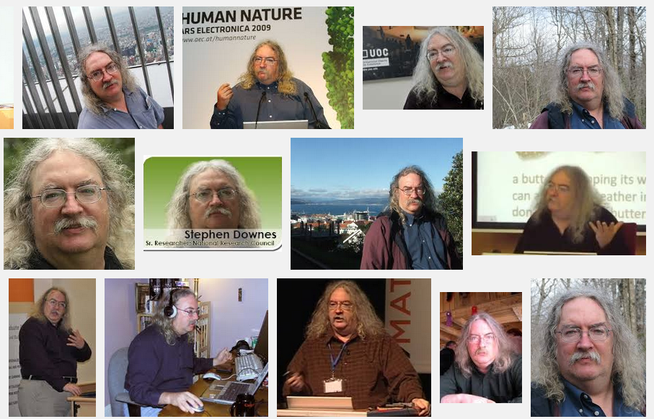
Stephen Downes http://www.downes.ca

